Slide 1
Telehealth…..
Role of Technology and Innovation in Telemedicine..

Slide 2
Telehealth
What is it?
Telehealth is:
•
Patient care services provided over distance using technology to
connect patients with physicians
A strategy that can:
•
•
•
•
•
Reduce cost of service
Support margins Improve access to care Improve quality of care
Telehealth is not:
•
A simple telephone conversation
or a fax transmission
An e-mail or text message
•
6

Slide 3
The Continuum of Telehealth Services
Clinician to Clinician
• TeleED Consults
• Tele-Specialty Consults
• Virtual Conferencing
• eICU
• Virtual Nurse Mentoring
• Clinical Education
• Grand Rounds
Consumer Driven
• Patient Web Portals
• Personal Activity Monitors
• Patient Scheduling Apps
• Quality/Price Transparency
Tools
• Geo-tagged Devices
• Mobile Apps
• Social Media
• Online Support Groups
Clinician to Patient
• Virtual Consults
❑ ED/Urgent Care
❑ Primary Care
❑ Specialty Care
• Remote Monitoring
• Telehealth Kiosks
• Virtual Medication
Management
7

Slide 4
II. Addressing Issues
and Challenges
12

Slide 5
Care in the Emergency Department
Common Issues
Rapid access to ED physician (door-to-provider time)
Access to specialist care (stroke, psych, trauma)
Prompt treatment for low acuity patients
Effective transitions to home / primary care
Timely admission process
30-day readmission issues (high-focus conditions)
Patient surges (Intra-day, certain days, seasonal)
Rural access to highly qualified ED physicians
Affordable Provider coverage model
Others (triage, hospitalist consultation, etc.)
•
•
•
•
•
•
•
•
•
•
13

Slide 6
Challenges
People Challenges
Organizational Challenges
Distribution and Reach
Recruiting skilled manpower
Tackling social issues and local beliefs ( Self medication)
Creating awareness among the rural consumers
Changing the mindset of the rural people
Affordability
Accessibility
Awareness
Quality of Healthcare Services

Slide 7
Telehealth in the ED
Where
and
When?
•
•
•
Before
During
the
the
ED visit
ED visit
After
the
ED
visit
14

Slide 8
Telehealth
“Before” the ED visit
Clinician-to-patient visit (“direct to consumer”)
•
–
Patient calls the ED with a health issue and the service offered could be:
• Advice only
• Patient care visit
•
Clinician-to-clinician
–
Outlying hospital calls tertiary center
(ED1 to ED2)
• Transfer, consult, admit, or discharge?
•
Telemonitoring for high-focus
conditions
15

Slide 9
Telehealth
“During” the ED
Visit
•
Provider up front
–
Rapid access to ED physician
•
Specialty care
–
Narrowly defined applications, such as
stroke, psych, trauma
•
Prompt treatment for low acuity patients
–
Fast track, etc.
•
TeleRadiology support
–
Immediate primary reads vs. preliminary reads from an after-hours service
•
Effective transitions to home / primary care
–
–
Address high risk patients (patient teaching, transition of care issues)
Address high-frequency patients
16

Slide 10
Telehealth
“During” the ED
Timely admission process
Visit
•
–
“Admissionist”
•
Patient surges
–
Intra-day, certain days, events, or seasonal
• Telemedicine as a solution
• Telemedicine as a bridge, before adding
a more costly 10 or 12 hour shift
•
Rural access to highly qualified ED physicians
–
–
ED to ED Consultation
Transfer decisions
•
30-day readmissions (high-focus conditions)
–
–
Focused management of CHF, pneumonia, COPD, etc.,
Clinical pathways, care coordination, and patient engagement strategies
17

Slide 11
Telehealth
“After” the
ED
Visit
•
Clinician- to- patient model
– Specific patient care follow-up
• High focus conditions
• High risk conditions
•
Clinician- to- clinician model
–
Follow-up of non-transferred
patients
• Specialty Care
• Hospitalist management
18

Slide 12
III.
of
Telehealth
Solution
19

Slide 13
Agenda
What is Telemedicine?
Provider Roles/ Services/
Network options/ Communication Options
Telemedicine
Portal
Regulatory Compliance
Medicare Telemedicine Payment Policies
Provider Documentation/
History Backup/Data Base
Hospitals/Medical Support/E Doctor Panel/ Department of health.

Slide 15
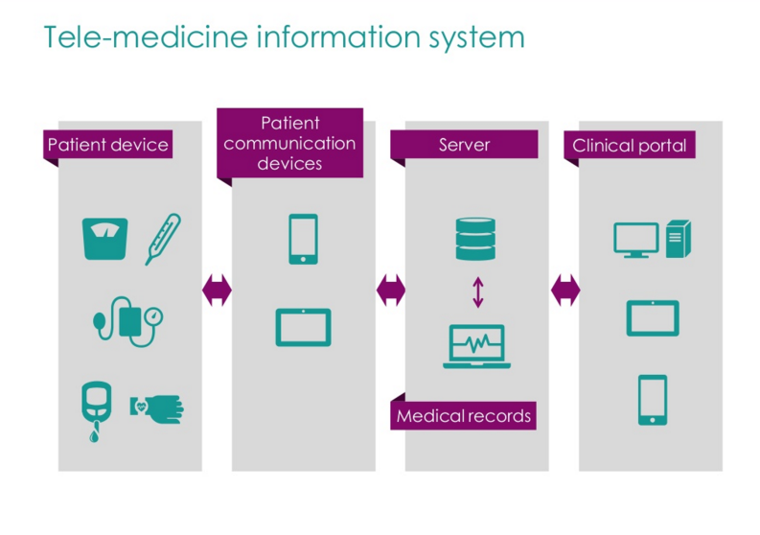

Slide 16
HOW IT WORKS
Step 1.
Medical history
Step 2.
Request consult
Step 3.
Talk with a physician
You are required to complete your medical history online, by phone, or by faxing a paper form prior to requesting a consultation.
You simply log on to your account or call Concierge Benefit Services’ toll free telemedicine line, 24/7/365, to request either a telephone or video consultation.
A board-certified physician licensed in your state reviews your medical history and provides a consultation over the phone or through video, just like an in-person visit.
Step 4.
Resolve the issue
Step 5.
Continuity of care
The physician recommends the right treatment for your medical issue. If a prescription is necessary, it is electronically sent to your pharmacy of choice.
The physician documents the results of the consultation in your medical history. Consultation information is sent to the health plan and can be sent to your primary care physician.
Notes:
16

Slide 17
Telehealth in the Emergency Department
Qualification Criteria
•
Clarification: What problems are we trying to solve?
•
Portals Put Together and make it ‘All in One’.
•
Financial justification/ROI
•
Technology: Network
bandwidth at client location
for video conferencing
22

Slide 18
Telehealth
Solution Options
Customized solutions can be built by software developers
•
Build
•
Multiple, proven vendor solutions are currently
available in the market
Buy
Lease
•
Solution can be acquired (3, 5, 7 year leases)
•
Some may have mobile cart/ video conferencing
solutions not currently being used in the ED
Borrow
Refer
•
To another providers service
23

Slide 19
IV. Impacts
and
Benefits
24

Slide 20
Telehealth
Key
Benefits
Financial
Quality
Access
• Reduced delivery costs
• Increased margin
• Fewer
• Reduced length of stay
• Fewer patient transfers
• Positive health interventions at earlier times in care
• Improved health outcomes
• More efficient care delivery
• Reduced or avoided time in skilled nursing units
• Enhances staffing capacity to meet patient needs, including surges
• Improved patient access to specialists
• Improved health system outreach
• Earlier patient diagnosis and treatment
readmissions/penalties
25

